Slide 1


Basic Programming using C++
by Aqilah Rose

Slide 2
“Your best quote that reflects your approach… “It’s one small step for man, one giant leap for mankind.”
- Neil Armstrong

Slide 3
Understanding a Compiler
You need a compiler to write a C++ program. A compiler is a computer program or application that translates a program written in C++ into another form of code which is known as an executable code.
Executable code (exe) is a set of instructions which is a computer readable and able to run a program or application on a computer.

Slide 4
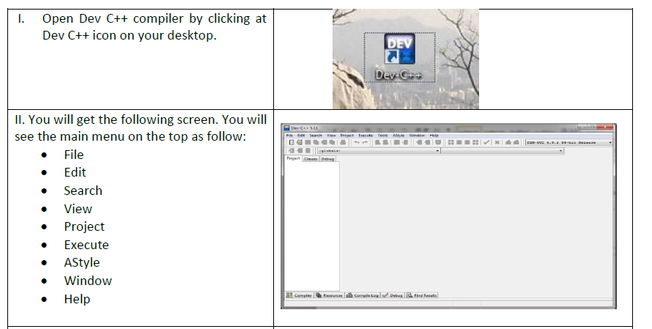

Slide 5
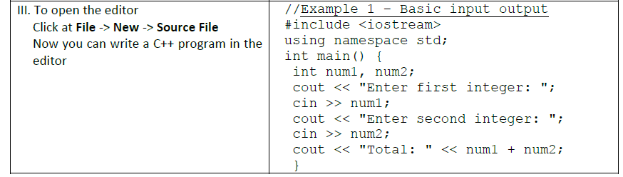

Slide 6
Recap and Additional References
Basic C++ program consists of the following:
Header file
Special statement “using namespace std” (option but highly recommended)
int main {….}
Set of C++ statements within int main () { … } function

Slide 7
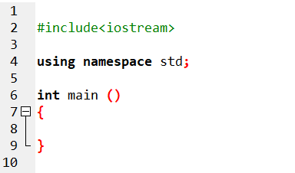
Basic C++ program

Slide 8
Header file
Each of C++ program must have a header file.
Each of header file consists of C++ specific command/function to be used in C++ statement.
Iostream- allows a programmer to use C++ command such as cin and cout and cmath allows a programmer to use C++ math command such as pow, sqrt, exp and many more.
To include C++ header file in a program, you should write the following statement:
#include <iostream>
iostream
cmath
conio
iomanip

Slide 9
Special statement “using namespace std”
To simplify the writing of C++ program. Without this special statement “using namespace std”, you have to write std::cout or std::cin in your C++ program.
You can simply write C++ codes by writing cin or cout in C++ statements.

Slide 10
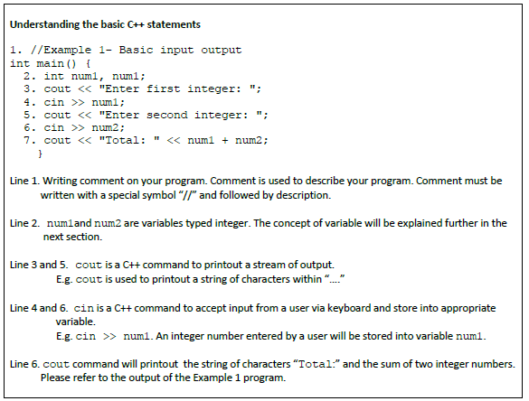

Slide 11
Variable
Variable is required to manipulate or compute data in a C++ program. Each variable is associated with its name and it has a container which allows a programmer to store or retrieve data in C++ program.
There are two types of data type in C++, which are basic data type and advanced data type. Example of basic data types are int, float, double, char, string and bool.
Example of advanced data type is 1-D array, 2-D array, linked list, queue and stack. 1-D array and 2-D array will be explained in the next section while linked list, queue and stack will be explained in Advanced Data Structure course.

Slide 12
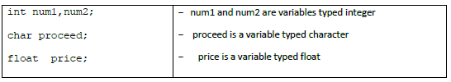
Variable (Cont.)
In a C++ program, variable must be firstly declared before it can be used. You can name the variable with whatever name. However, it’s strongly advice to name the variable with a meaningful name. The following is the example of variable declaration:

Slide 13
Rules of naming variables in C++ program
Variable name should consists only characters, digits, and underscore (“-“)
Variable name must begin with character or underscore
Variable name cannot have two or more split words
Variable is a case sensitive. Upper case and lower-case character are considered differently

Slide 14
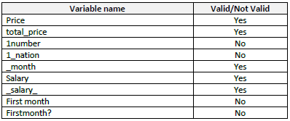
Rules of naming variables in C++ program (Cont.)
If you do not follow the variables naming rules above, C++ compiler will give an error when the program is compiled. The following is the example of valid and not valid variables name:

Slide 15
Concept of assignment in C++ statement
In C++, we must assign a value into a variable using assignment operator “=”. In C++ “assign” means copy the right value of “=” operator and store the value into the left variable of the “=” operator.
Generally, C++ statements in main () function is evaluated from top to bottom
and for each statement in C++ is evaluated from right to left.

Slide 16
C++ Statement is evaluated from right to left
=
Num1
+
Num2;
Total

Slide 17
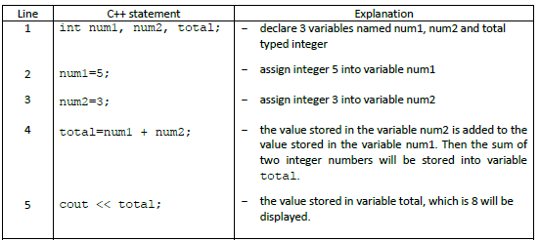

Slide 18
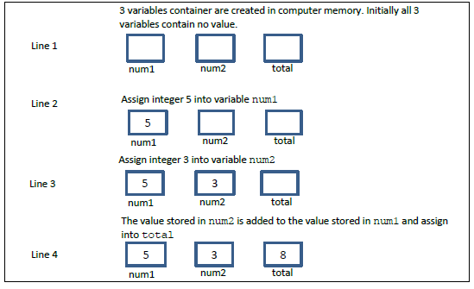
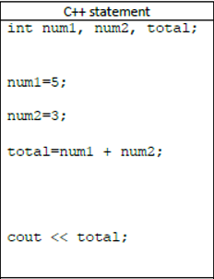
You can imagine the processes of assignment are as follow:
Note: You should relate with C++ statements and its explanation above.
1
2
3
4

Slide 19
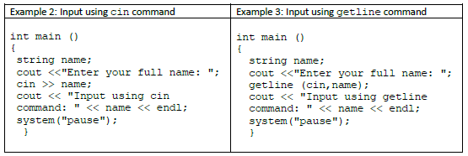
Input
In C++, normally cin or getline is used as input command to accept input from a user typed via keyboard.

Slide 20
Learning experience
Type the program as in the example 2 and example 3, compile and run the program.
Enter your full name. What is the difference between cin and getline command?

Slide 22
cin vs getline vs cin.get()
cin | getline | cin.get()
is used to read input from the standard input device which is usually a keyboard. The extraction operator(>>) is used along with the object cin for reading inputs. terminates when whitespace is found | It is a part of the <string> header. The getline() function extracts characters from the input stream and appends it to the string object until the delimiting character is encountered. | cin.get() is used for accessing character array. It includes white space characters. cin.get() reads a string with the whitespace.

Slide 23
Output
Organizing the output of your program in well form is important so that users can use your program and read the output easily. You can set the layout of the output as follows:
to display the output in different line
to align the output from left to the right of the screen
To display the float number with specific decimal number.
To display the output in different line:
use “\n” or “endl” command

Slide 24
Output (Cont.)
(ii) To align the output from left to the right of the screen:
To align the output means that you can shift the output from left to the right of the screen.
You can use “\t” command.
Another option is you can also use cout.width(n)command. n is an integer number which specifies the position the output on the screen.
The program in example 4 uses “\n”, “endl”, “\t” and cout.width(n)command.

Slide 25
Learning experience 3
Type the program as in the example 4, compile and run the program. You should learn based your experience through practical and your observation. Try to relate with the basic output command with the program output after running the program

Slide 26
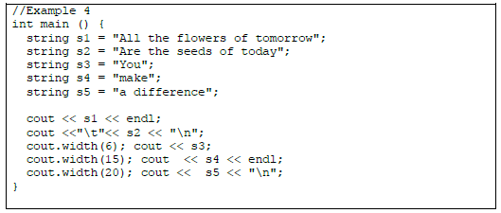

Slide 27
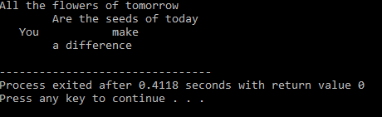

Slide 28
Float Number
(iii) Display the float number with specific decimal number:
To set decimal number you should:
include C++ header file: “include <iomanip>” in a program
use command fixed, showpoint and setprecision(n).
n is an integer number to specify the number of decimal point.
For example: cout <<fixed << showpoint << setprecision(2). Set the output to display 2 decimal points.

Slide 29
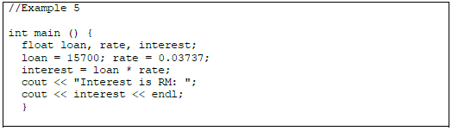

Slide 30
Learning experience 5
Type the program as in example 5, compile and run the program. What is the output?.

Slide 31
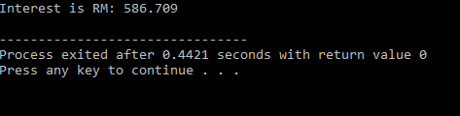

Slide 32
How to display interest with 2 decimal points only?
Modify your program above by adding the following command
cout << fixed << showpoint << setprecision(2);
after the statement “interest = loan * rate;”. Compile and run the program again. Now, what is the output?

Slide 33
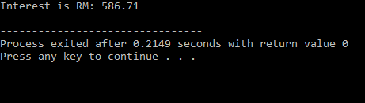
w/o precision
With precision

Slide 34
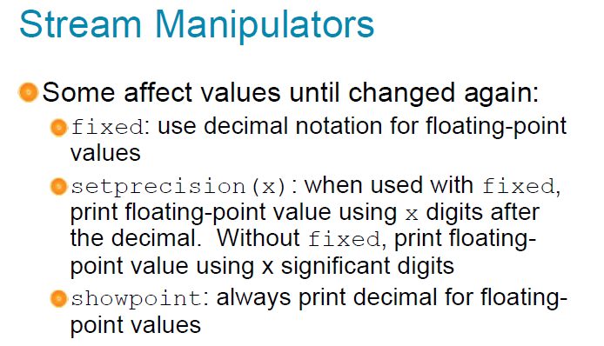

Slide 35
Understanding errors
Commonly, there are 3 types of program errors. There are:
Syntax error
Logic error
Execution error

Slide 36
Syntax errors
Syntax error occurs due to incorrect uses of programming language command or rule. Syntax error can easily be detected. A compiler normally can detect the error when a program is compiled. A good compiler can show and identify which line in the program has error. E.g. Dev C++ compiler. Example of syntax errors are:
no semicolon “;” at the end of C++ statement
use command cout or cin without include C++ header file <iostream>
use variable without declaration
typo error. E.g. Cout, Cin, c0ut.
incorrect use of command in C++ statement. E.g. a * b = c; it should be c = a * b;
You will not succeed to compile a program with syntax errors. Therefore, you should correct all the syntax errors found in your program.

Slide 37
Logic error (also known as design error/semantic errors)
Logic error occurs due to lack of logical thinking of a programmer. Logical error may arise from analysis or design phase in the problem-solving method. Normally, logic error is difficult to detect by a compiler.
You can compile your program without any syntax errors. However, your program produces incorrect output as expected. Examples of logic errors are:
C++ statements are not arranged in a proper sequence
apply incorrect formula in C++ statement.
logic operator is not used correctly

Slide 38
Execution error
Execution error occurs while you run a program. Normally, a compiler cannot detect execution errors. Examples of execution errors are:
when there is a C++ statement divides integer number with zero
looping error. E.g. infinite loop.

Slide 39
Learning experience 6
This program in example 6 is written to compute BMI index of a person. The program will accept 2 inputs from a user then compute BMI index and finally display the BMI index of a person.
Formula: bmi = weight (in kg)/height^2 (in meter)
Referring to Example 6, what types of the errors exist in the program?
Type and compile the program. Identify those errors and errors message.
Correct all the errors, compile again and run the program.

Slide 40
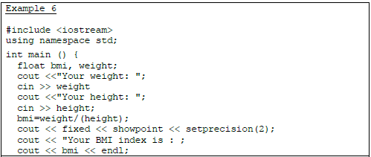
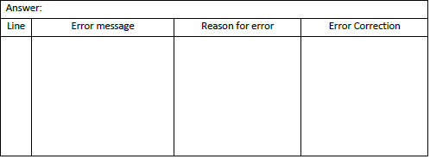

Slide 41
Operators
Operator represents an action. For example + is an operator that represents addition. An operator works on two or more operands and produce an output.
For example 3+4+5 here + operator works on three operands and produce 12 as output.
1) Basic Arithmetic Operators 2) Assignment Operators 3) Auto-increment and Auto-decrement Operators 4) Logical Operators 5) Comparison (relational) operators 6) Bitwise Operators 7) Ternary Operator

Slide 42
Precedence vs Associativity
Precedence | Associativity
determines which operator is performed first in an expression with more than one operators with different precedence. | Is used when two operators of same precedence appear in an expression.

Slide 43
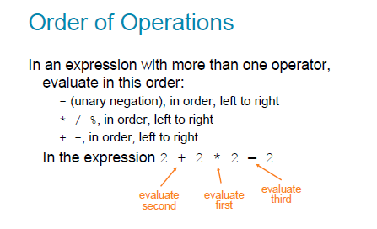

Slide 44
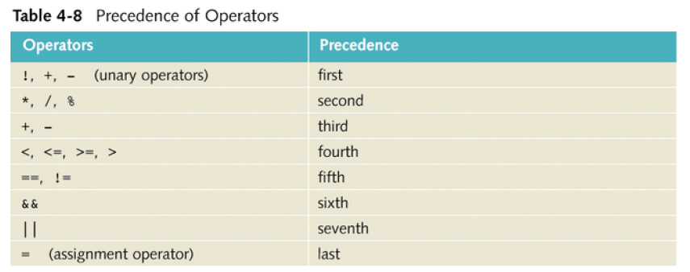

Slide 45
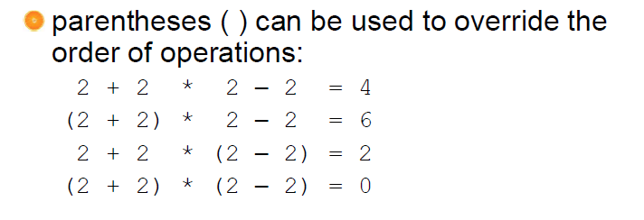

Slide 46
SOLUTIONS

Slide 47
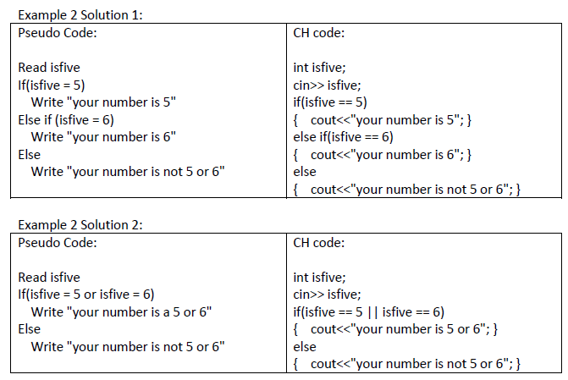
Solution for example 2 (3 ways)

Slide 49
